Slide 1


BUSINESS ANALYSIS
ASSIGNMENT

Slide 2
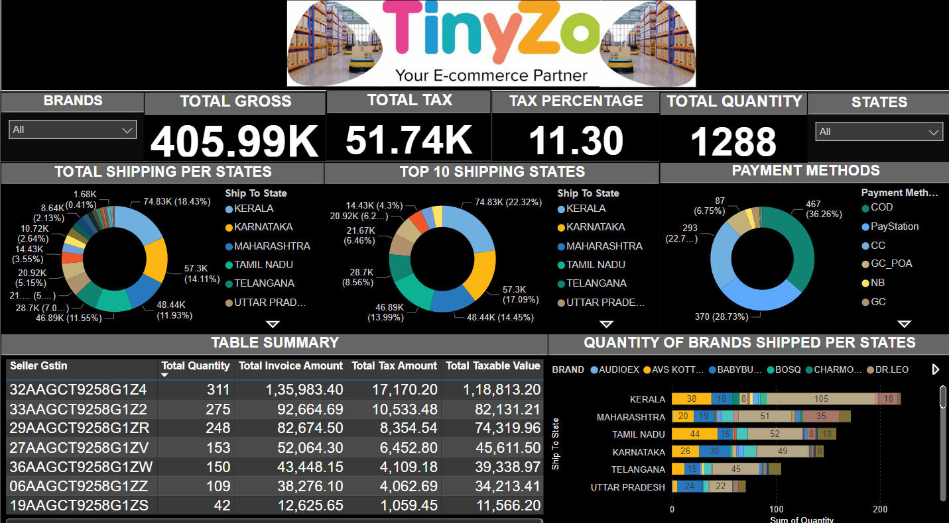
FINAL ANALYSIS
Notes:
From a total of 1288 quantity shipped we got a gross of 405.99K excluded from total tax of 51.74K in the rate of 11,30%

Slide 3
TABLE SUMMARY
Seller Gstin | Total Quantity | Total Invoice Amount | Total Taxable Value | Total Tax Amount
06AAGCT9258G1ZZ | 109 | 38276.1 | 34213.41 | 4062.69
19AAGCT9258G1ZS | 42 | 12625.65 | 11566.2 | 1059.45
27AAGCT9258G1ZV | 153 | 52064.3 | 45611.5 | 6452.8
29AAGCT9258G1ZR | 248 | 82674.5 | 74319.96 | 8354.54
32AAGCT9258G1Z4 | 311 | 135983.4 | 118813.2 | 17170.2
33AAGCT9258G1Z2 | 275 | 92664.69 | 82131.21 | 10533.48
36AAGCT9258G1ZW | 150 | 43448.15 | 39338.97 | 4109.18
Notes:
Showing summary of each Seller Gstin wise Quantity, Invoice amount, Taxable value and Tax amount.

Slide 4
BRAND WISE QUANTITY SOLD
BRAND | Total Quantity Sold
ORGANIC HABITS | 518
BABYBUTTONS | 199
AVS KOTTAKKAL | 165
YAAMA | 110
SOFT N COOL | 91
LUNCH BOX | 57
RAINBOW | 16
FEEL&HEAL | 14
HERMAS LIFE | 13
RICH ELEMENTS | 11
CHARMOWN | 11
SALIAH DATES | 10
MUNJINGS | 10
GLITTERS | 9
OSKIL | 8
FLAIR | 8
WAREFLUX | 7
MUNDO | 7
GLORY | 6
BOSQ | 5
TIMSON | 4
AUDIOEX | 3
POTATO MASHER | 2
PURVINA | 2
TINY MAFIA | 1
DR.LEO | 1
Notes:
Showing brand wise quantity sold. Most sold brand was ‘ORGANIC HABITS’ and least sold brand is ‘TINY MAFIA’ and ‘DR.LEO’.

Slide 5

SUM OF QUANTITY SHIPPED TO EACH STATES
Ship To State | Total Quantity Sold
KERALA | 220
MAHARASHTRA | 172
TAMIL NADU | 158
KARNATAKA | 146
TELANGANA | 105
UTTAR PRADESH | 71
WEST BENGAL | 65
ANDHRA PRADESH | 53
DELHI | 43
GUJARAT | 37
PUNJAB | 26
MADHYA PRADESH | 26
HARYANA | 22
RAJASTHAN | 22
BIHAR | 20
ASSAM | 19
ODISHA | 16
CHHATTISGARH | 10
JHARKHAND | 9
UTTARAKHAND | 9
HIMACHAL PRADESH | 6
GOA | 6
MANIPUR | 6
JAMMU & KASHMIR | 6
TRIPURA | 5
PUDUCHERRY | 3
ANDAMAN & NICOBAR ISLANDS | 2
MIZORAM | 2
MEGHALAYA | 1
DADRA AND NAGAR HAVELI AND DAMAN AND DIU | 1
ARUNACHAL PRADESH | 1
Notes:
Most quantity shipped to Kerala(220)

Slide 6
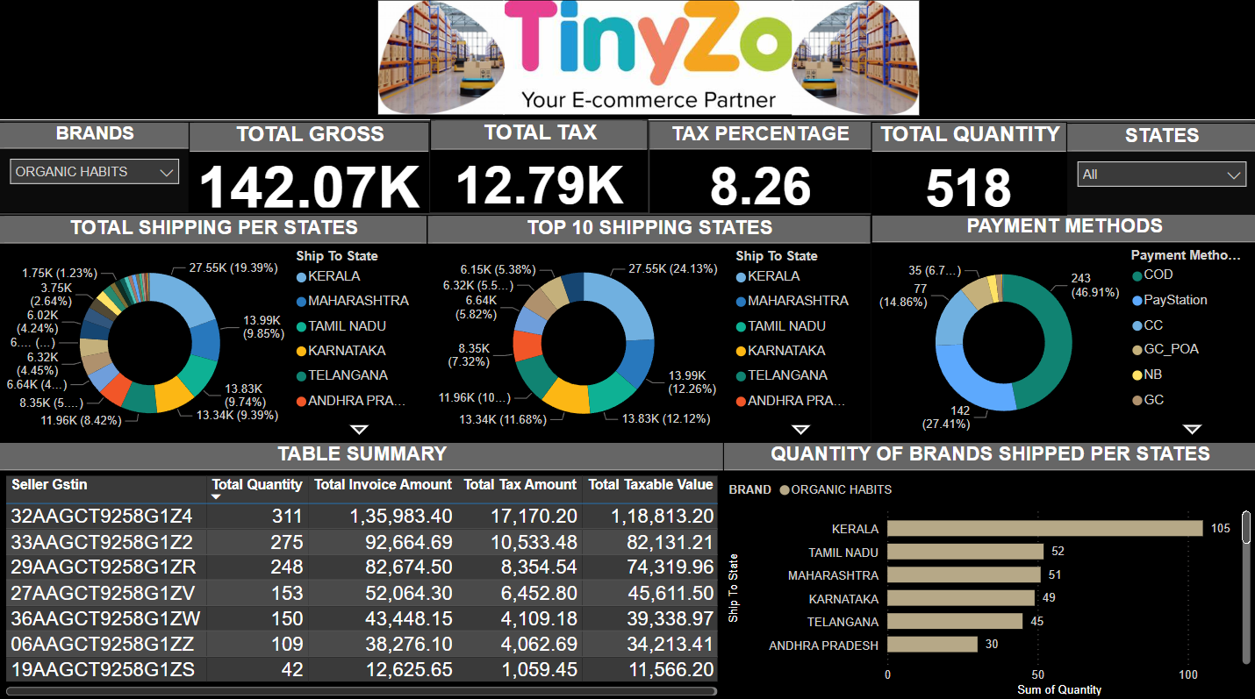
Tax percentage of Brand "ORGANIC HABITS"
Notes:
SKU wise Tax percentage of Brand "ORGANIC HABITS“. Organic Habits had a total tax percentage of 8.26.

Slide 7
From a total of 1288 quantity shipped we got a gross of 405.99K excluded from total tax of 51.74K in the rate of 11,30%
Most sold brand was ‘ORGANIC HABITS’ and least sold brand is ‘TINY MAFIA’ and ‘DR.LEO’.
Most quantity shipped to Kerala(220) and least shipped to MEGHALAYA, ARUNACHAL PRADESH, DADRA AND NAGAR HAVELI AND DAMAN AND DIU with (1) quantity each
SKU wise Tax percentage of Brand "ORGANIC HABITS“ is 8.26.
Most of the payment methods chosen by the customers are cash on delivery (467)with a percentage rate of 36.26% followed by pay station payment method (370) 28.73% and credit card payments(293) of 22.75%. Least usage was cc play station (1) 0.8%

